Slide 1

BANK DATABASE
MADE BY
-Lakhan Agrawal(B223)
-Kaushal Prajapat(B218)
-Krushna patil(B201)
-Ayush Tiwari(B228)
Guided BY: Dr Hemant Gianey

Slide 2

CONTENTS -
Introduction
ER diagram
Relational model
Constraints
Queries

Slide 3
INTRODUCTION
Bank Database Management System The purpose of this project is to create a database management system for a bank. The DDL and DML statements have been written using Oracle PL/SQL developer. This project intends to provide a simplistic approach towards designing a database for a banking system. In any banking database system the most important relationship is that of the customer to the account. In general there are several categories and types of accounts a customer can have. For this project I have taken into consideration the following types of accounts: -
Savings
Checking

Slide 4
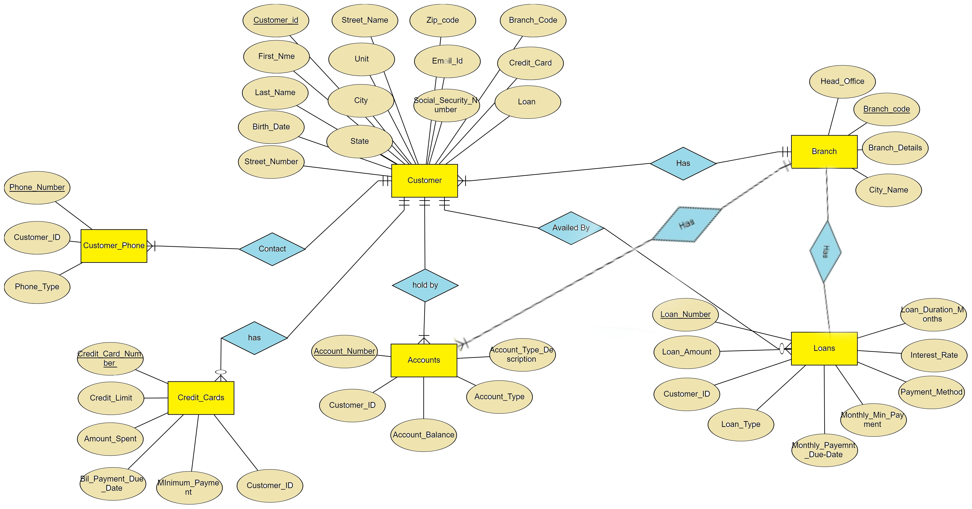
ER DIAGRAM

Slide 5
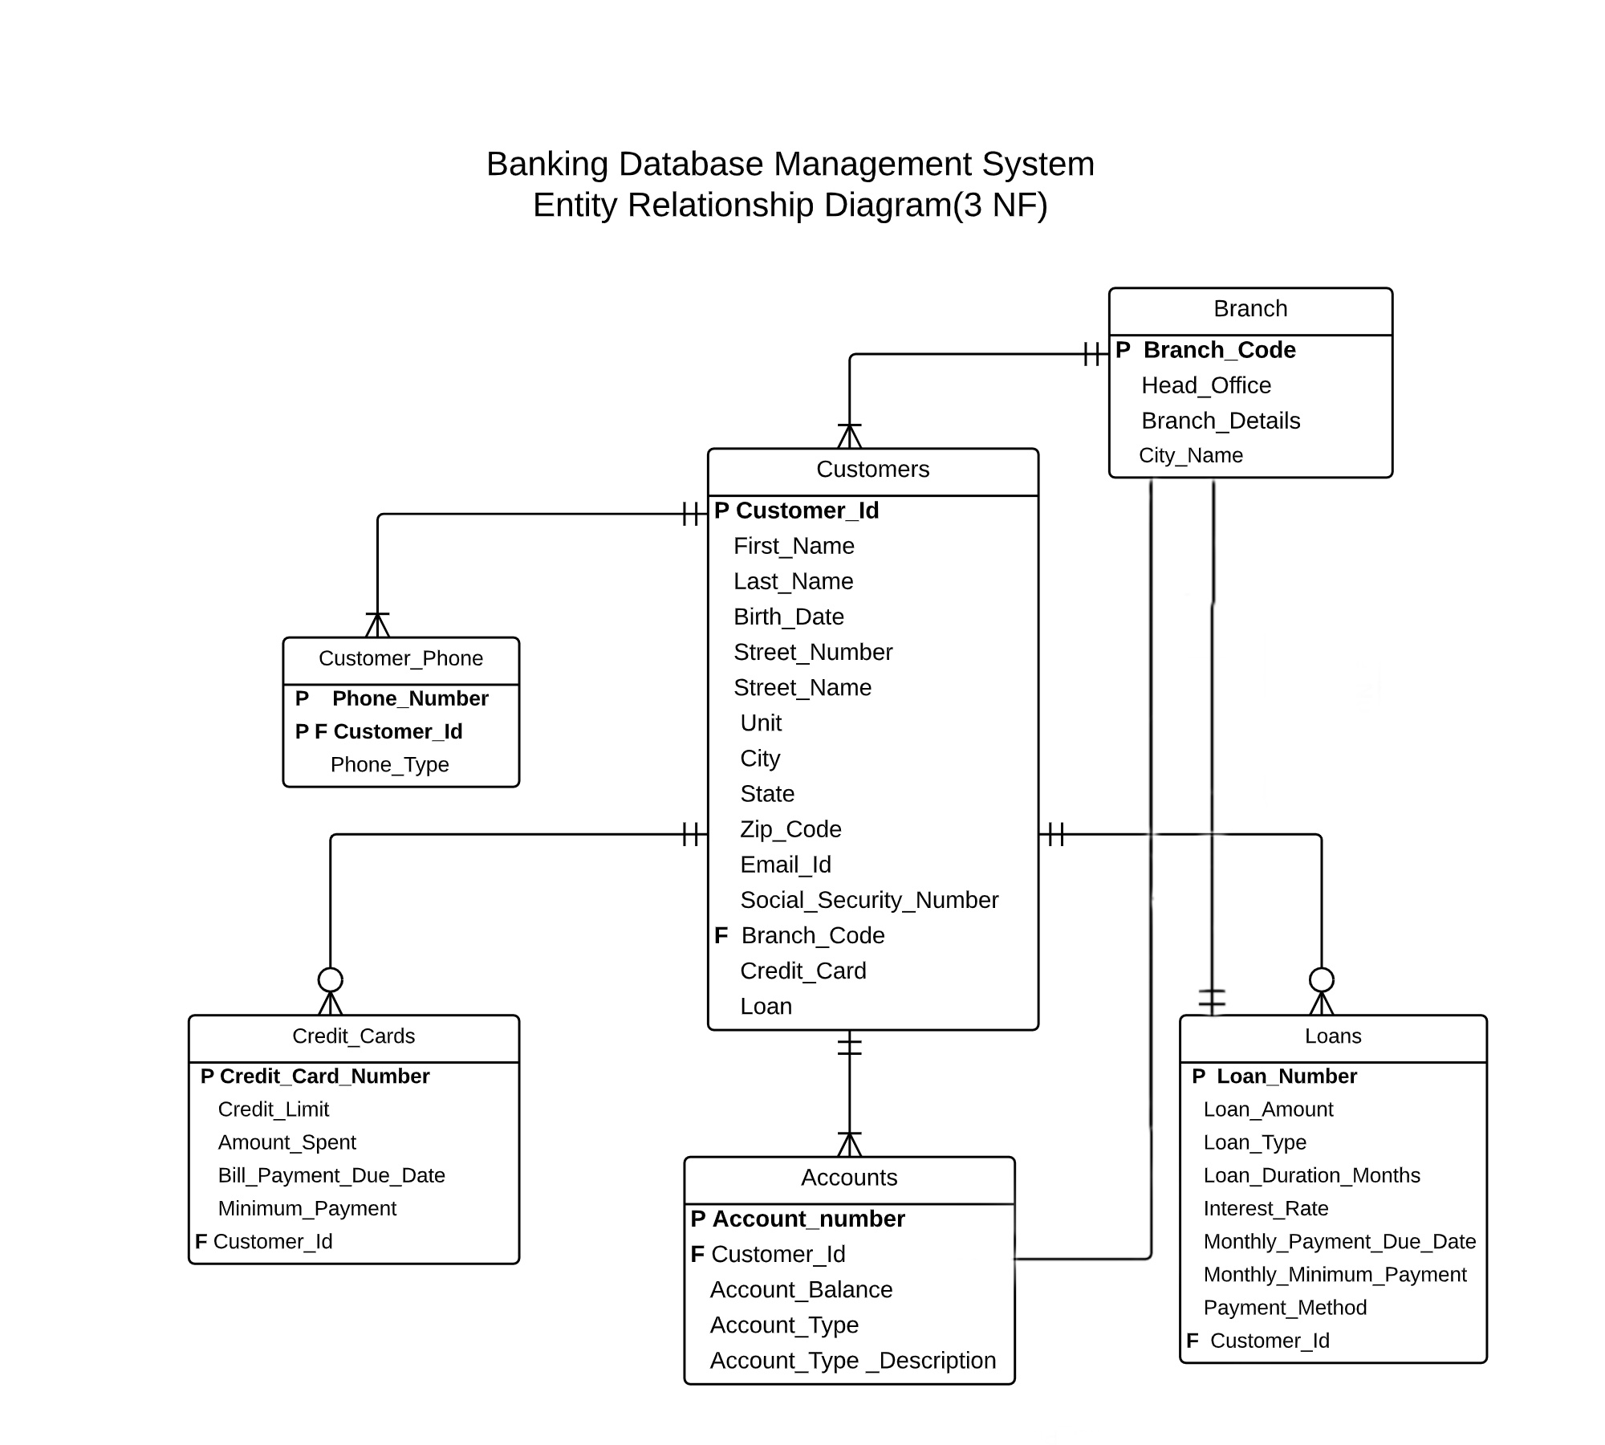
RELATIONAL MODEL-

Slide 6
Table and ATTRIBUTES
Customer_Phone
P Phone_Number
P F Customer_id
Phone_type
Branch
P Branch_code
Head_office
Branch_details
City_names
Credit_Cards
Credit_Limit
Amount_spent
Bill_Payment_due_date
Minimum_Payment
F Customer_id

Slide 7
Table and ATTRIBUTES
Accounts
P account_Number
F Customer_id
Account_Balance
Account_Type
Account_Type_Descripition
Loans
P Loan_Number
Loan_Amount
Loan_Type
Loan_Duration_Months
Intrest_Rate
Monthly_Payment_due_date
Monthly_Minimum_Payment
Payment_Method
F Customer_Id
Customers
P Customer_Id
First_Name
Last_Name
Birth_Date
Street_Number
Street_Name
Unit
City
State
Zip_Code
Email_id
Social_Security_Number
F Branch_Code
Credit_Card
Loan

Slide 8
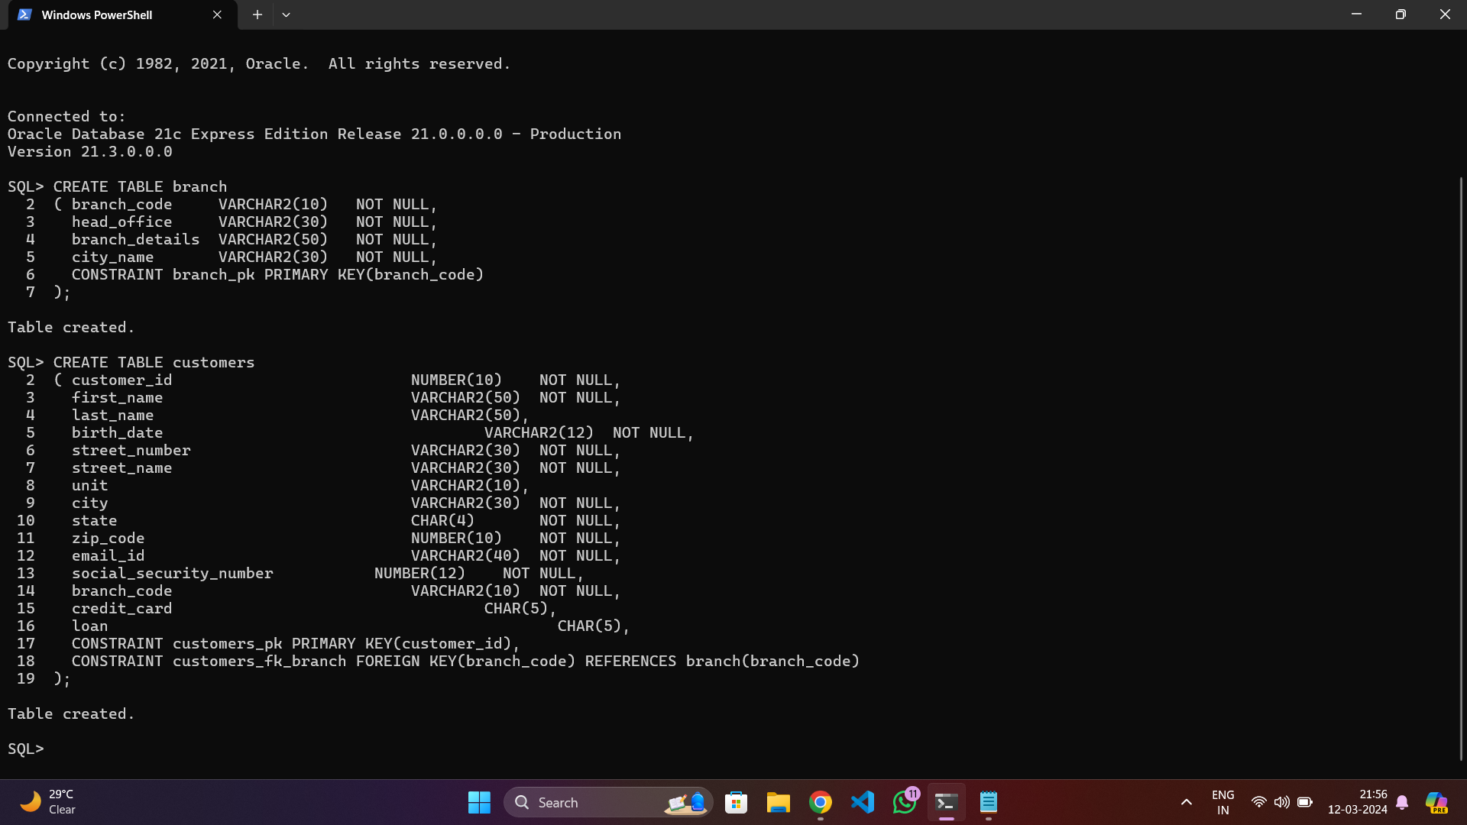
Table Creation Commands -

Slide 9
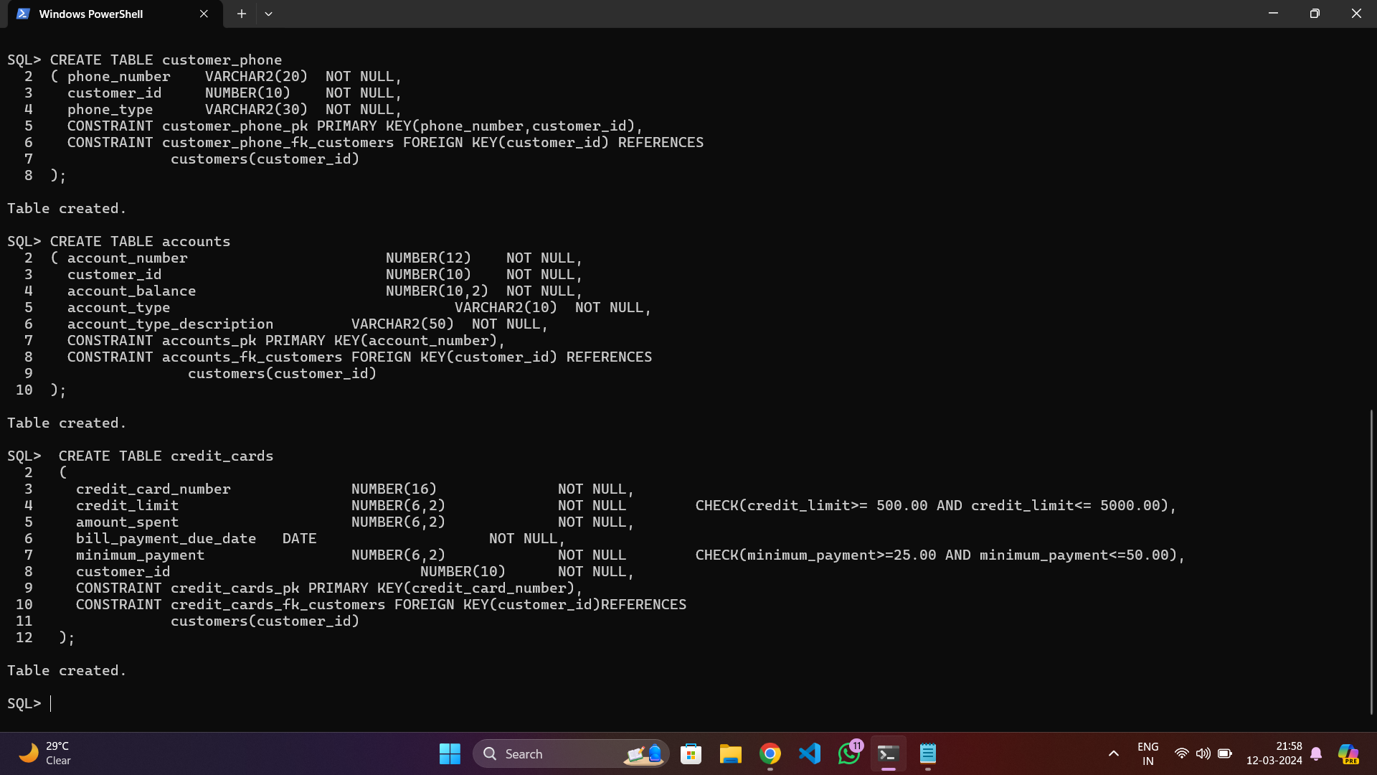

Slide 10
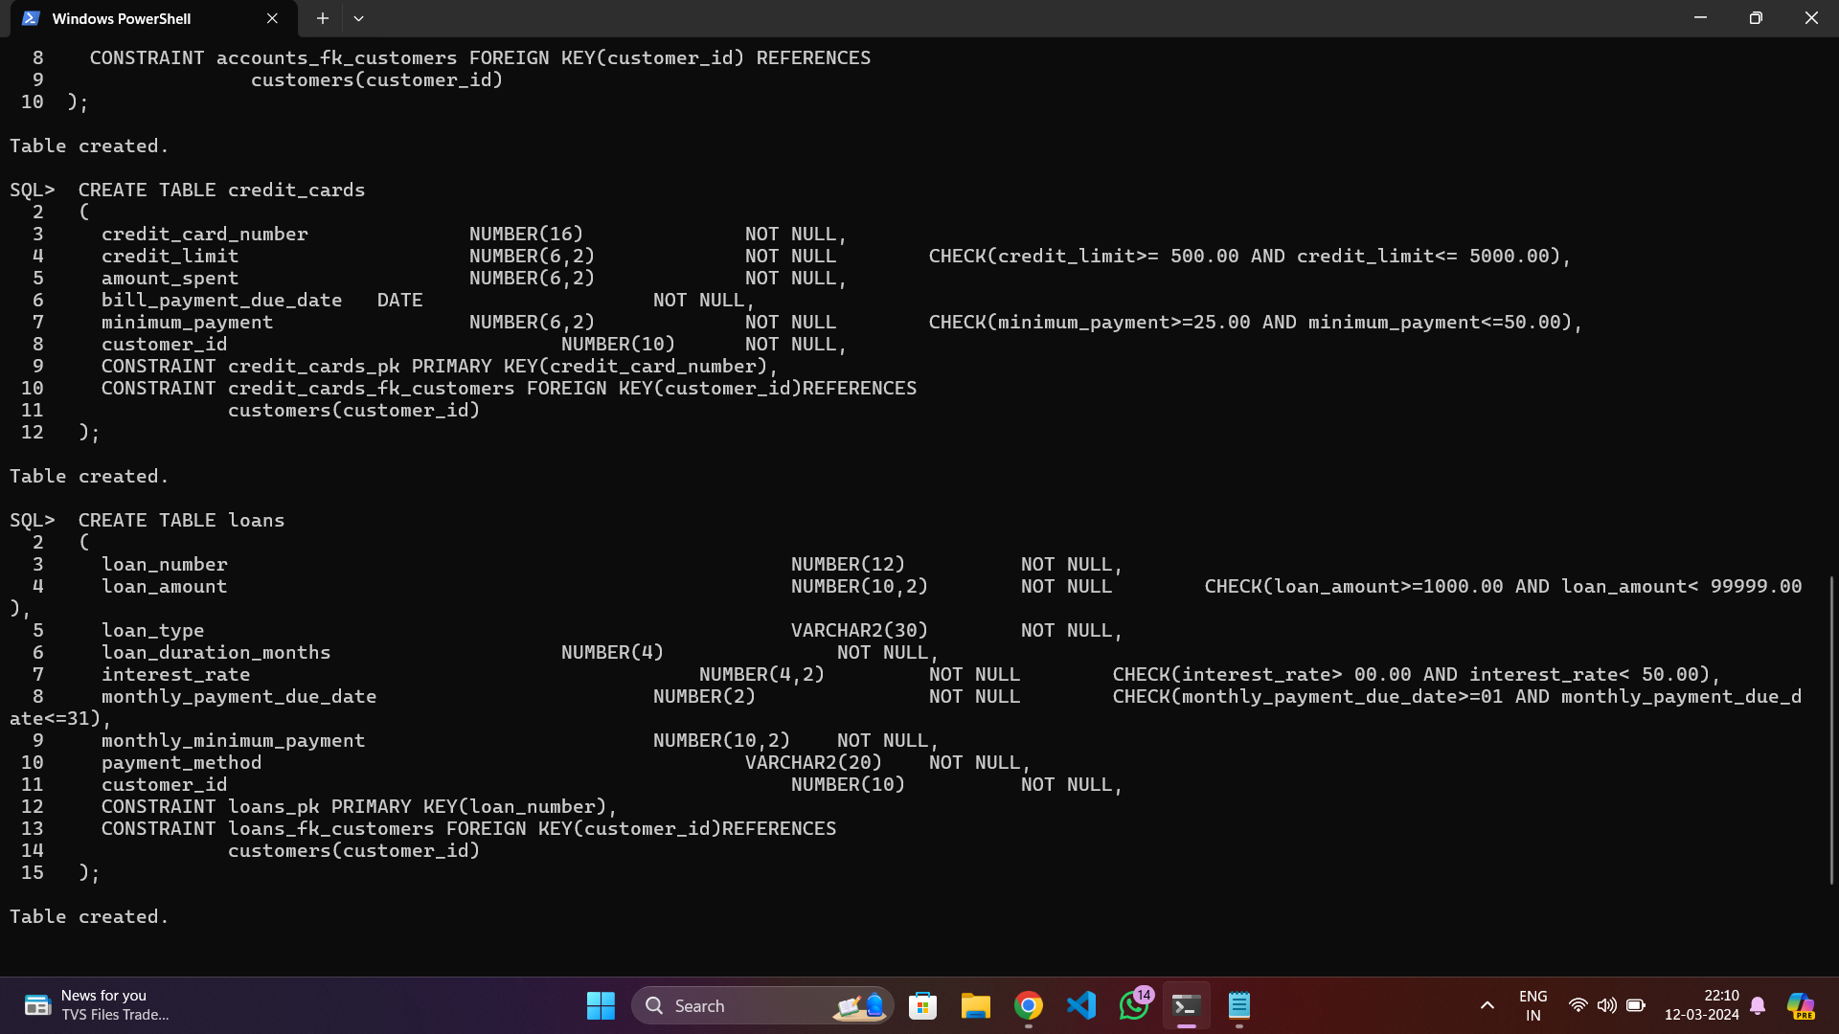

Slide 11

Entries in Table:

Slide 12
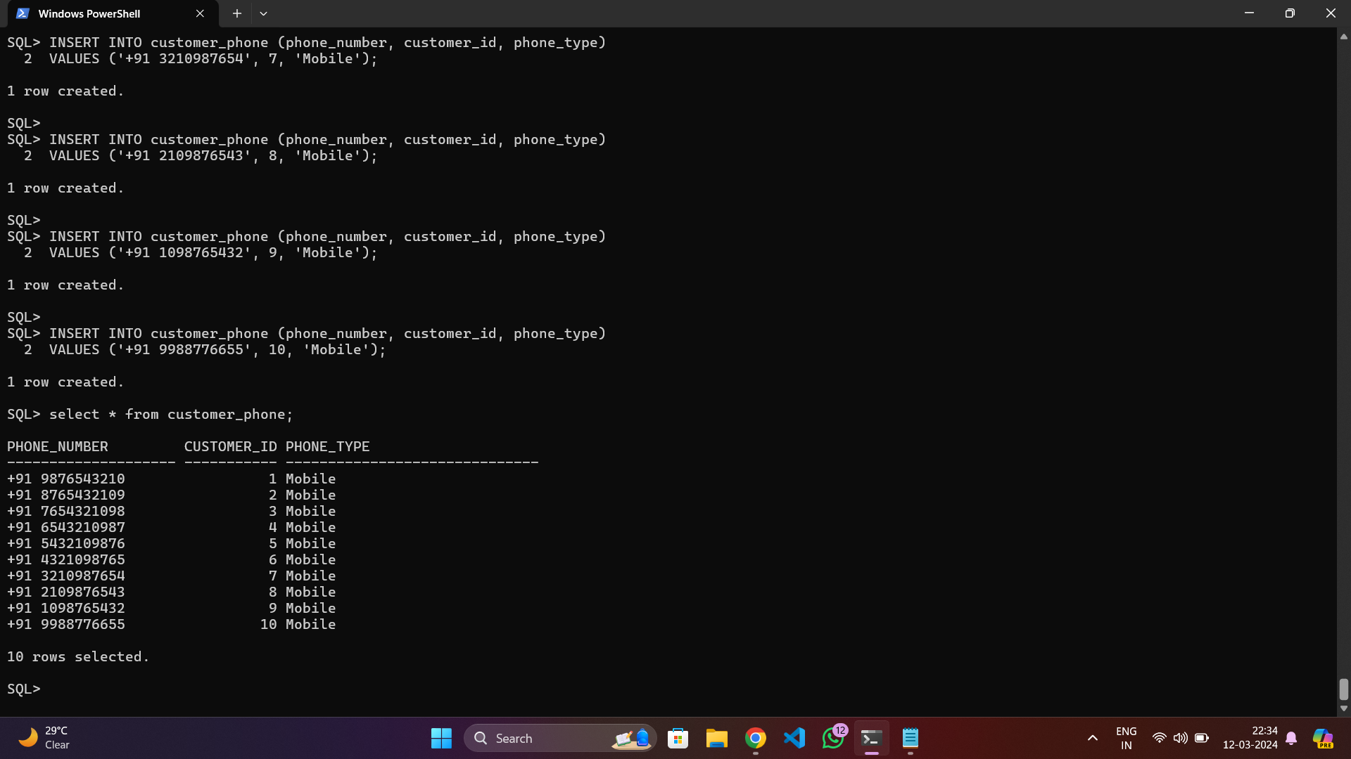

Slide 13
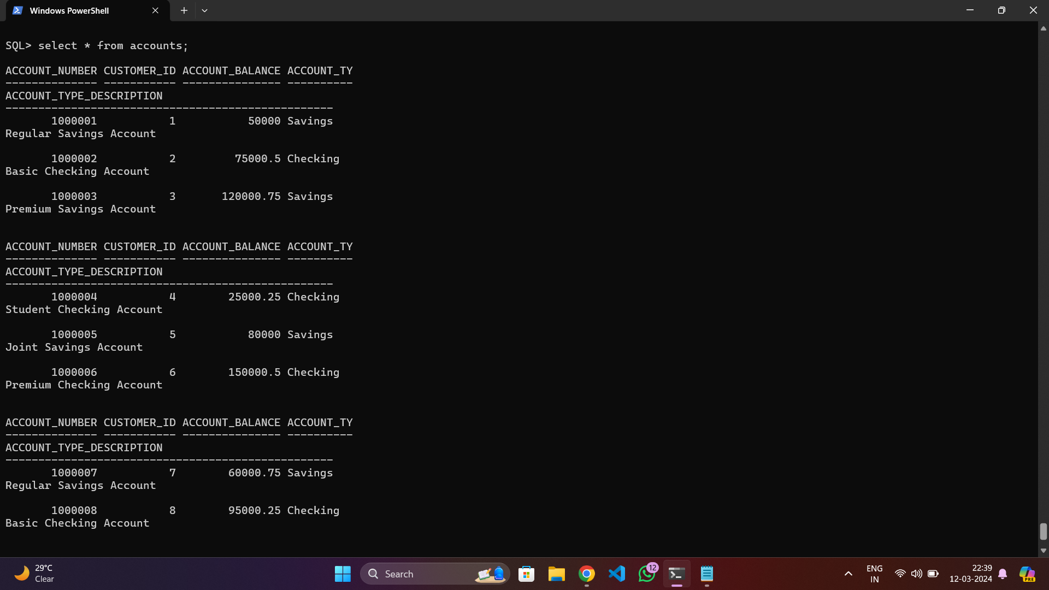

Slide 14
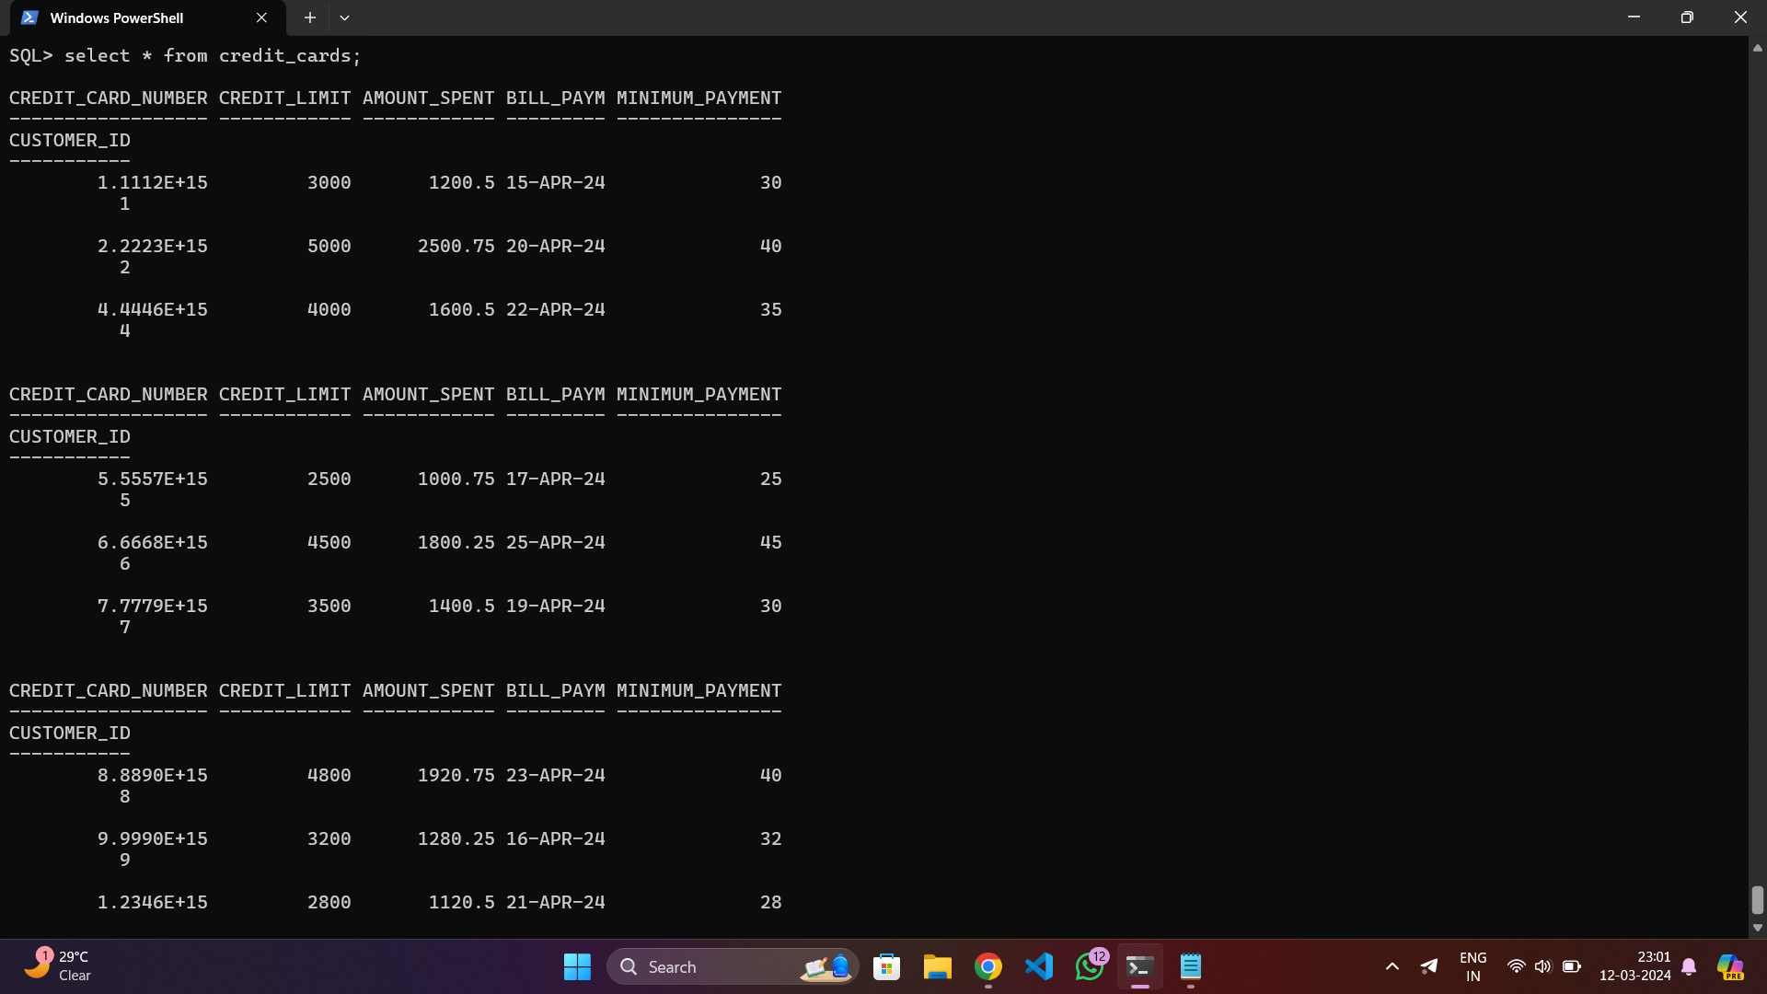

Slide 15
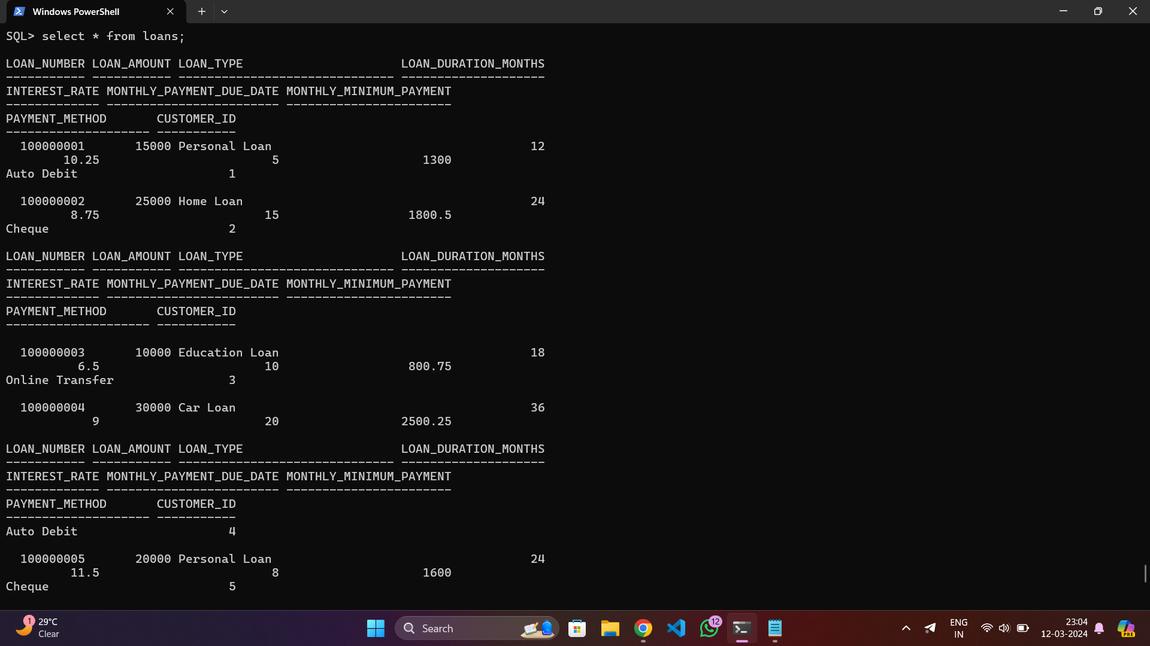

Slide 16

QUERIES : ---------→

Slide 17
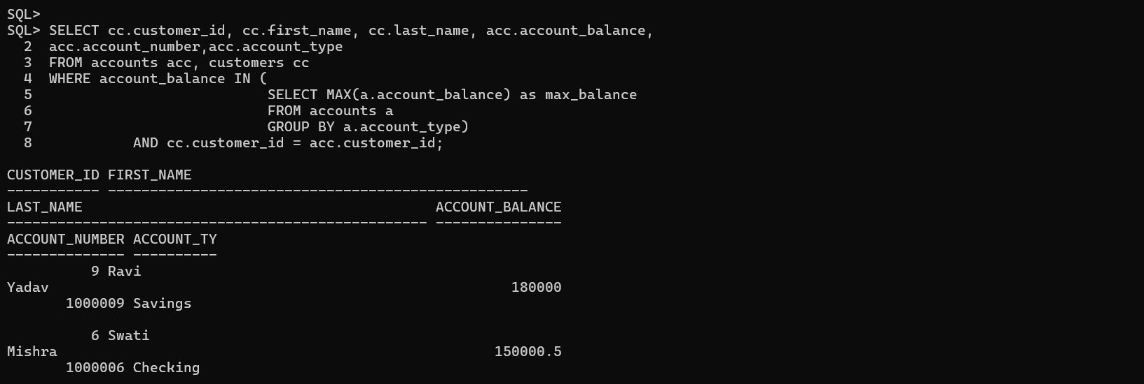
Different types of accounts that have been opened up by customers at the
bank. Also get the maximum balance with respect to each of the account types and
the customer details with respect to those accounts.

Slide 18
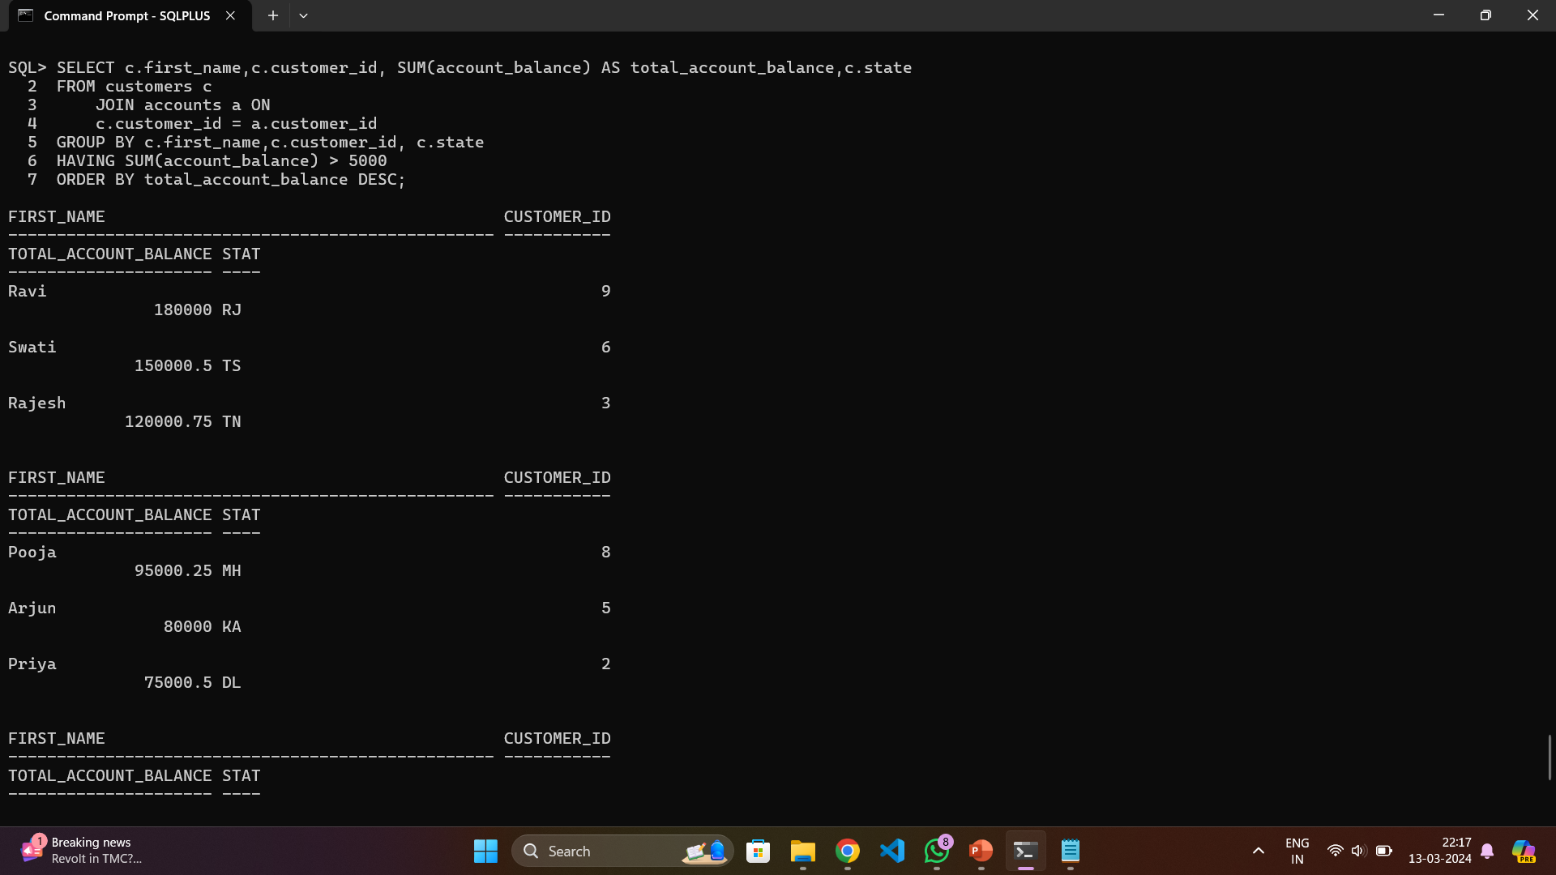
Query to find out the customers that have more than $5000 with the bank.
Order the result set by total_account_balance in descending order.

Slide 19
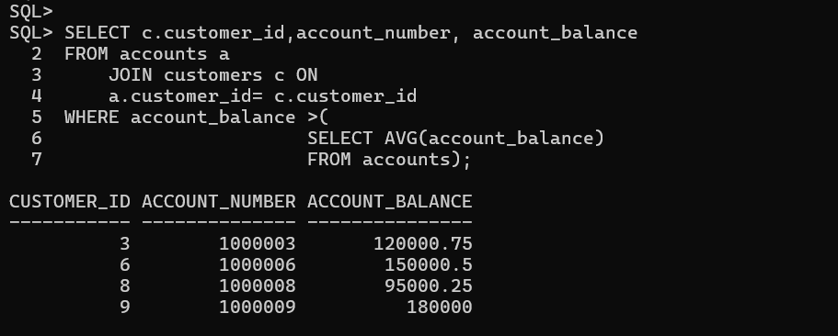
Query that returns the account_balances that are greater than
the average account_balance for all the accounts.Return the customer_id,
account_number and account_balance for each customer

Slide 20
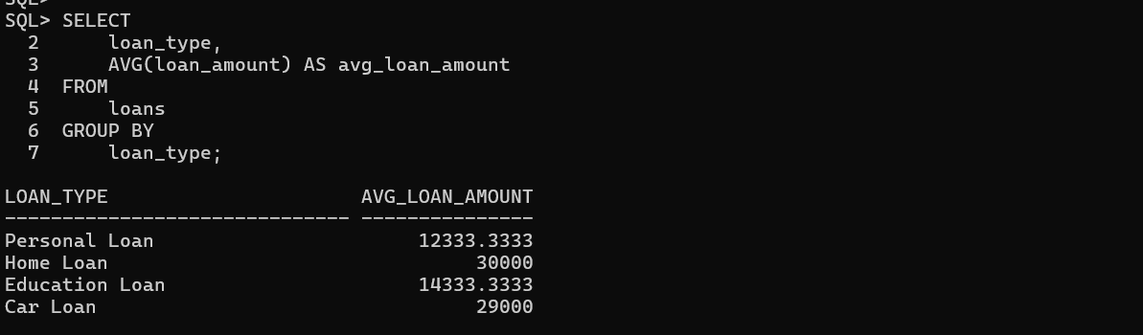
This query calculates the average loan amount for each loan type.

Slide 21
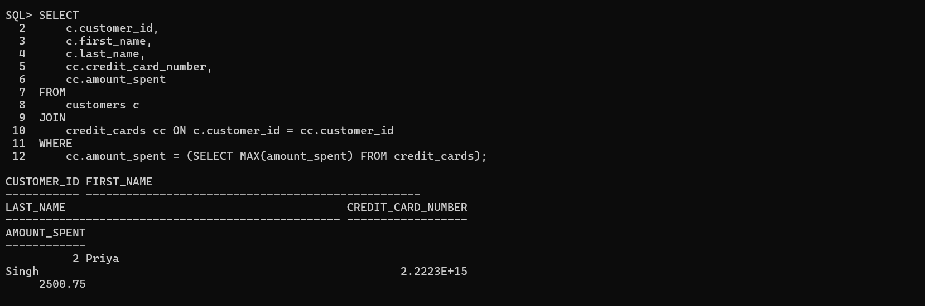
This query lists customers along with their credit card details who have the maximum credit card debt.

Slide 22
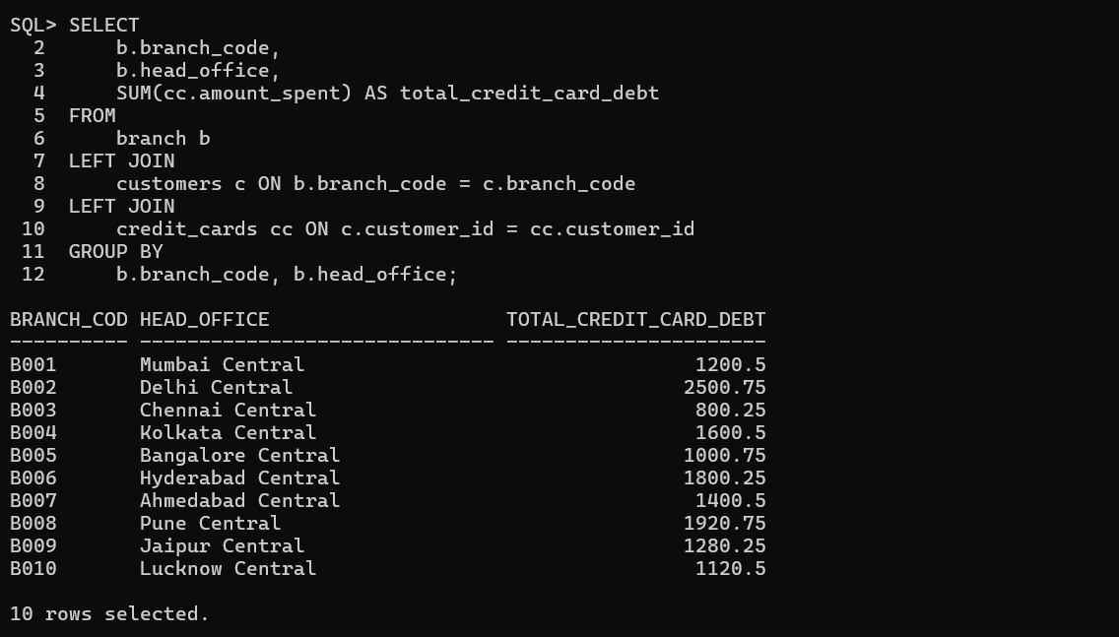
This query calculates the total credit card debt for each branch.

Slide 23
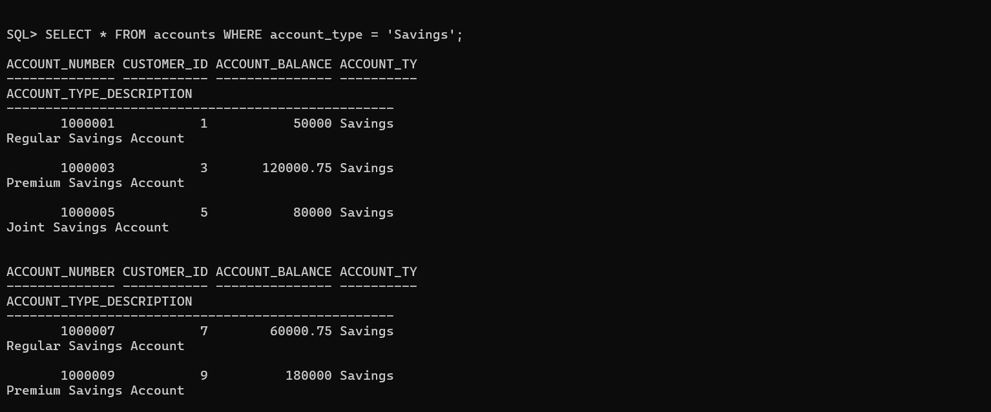
Show All Savings Accounts:

Slide 24
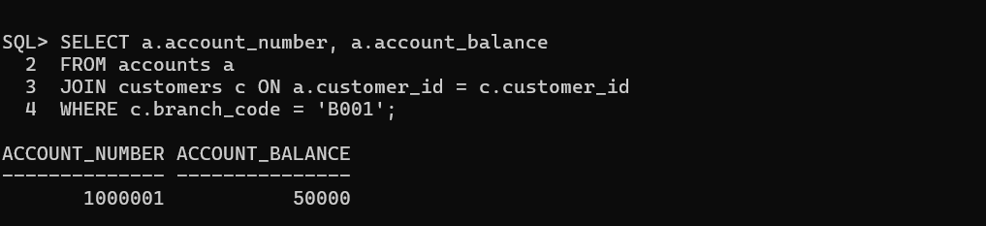
Retrieve Account Balances for a Specific Branch:

Slide 25
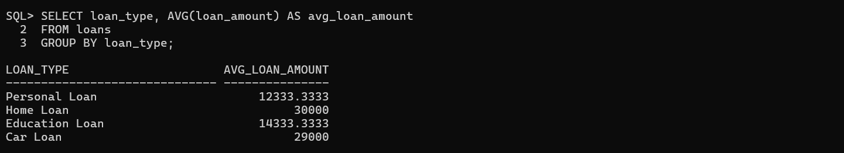
Show the Average Loan Amount for Each Loan Type:

Slide 26
THANK YOU…

